Slide 1

Study Report
Fu Kangwei
2019.10.21

Slide 2
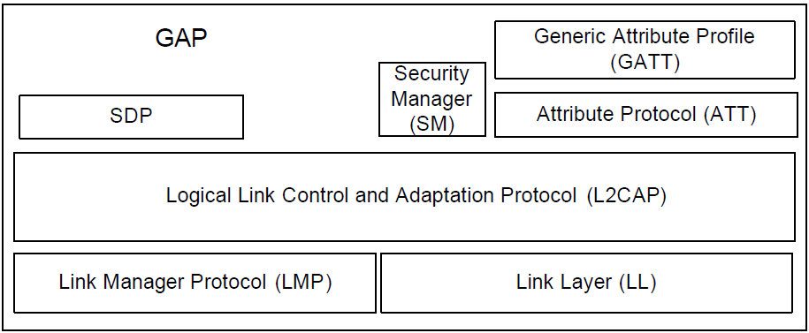
Generic Access Profile
The purpose of Generic Access Profile is to describe:
Profile roles.
Discoverability modes and procedures.
Connection modes and procedures.
Security modes and procedures.

Slide 3
Generic Access Profile
State the requirements on names, values and coding schemes.
Define the general procedures used for discovering identities, names and basic capabilities of other Bluetooth devices.
Define the general procedure for how to create bonds between Bluetooth devices.
Describe the general procedures used for establishing connections to other Bluetooth devices.

Slide 4
User Interface Level
Places where Bluetooth device users encounter names, values and numerical representation of Bluetooth terminology.
BD_ADDR: Address received from a remote device during the device discovery procedure.
Baseband Level: BD_ADDR is represented as 48 bits.
UI Level: BD_ADDR is represented as 12 hexadecimal characters.
000C3E3A4B69 or 00:0C:3E:3A:4B:69

Slide 5
Bluetooth Device Name
User-friendly name that a Bluetooth device exposes to remote devices.
For LE-only device type, the name is a character string held in the Device Name characteristic.
Up to 248 bytes.
Encoded according to UTF-8.

Slide 6
Bluetooth Passkey (Bluetooth PIN)
Authenticate two Bluetooth devices with each other during the creation of a mutual link key.
PIN can be not only entered on the UI level but also be stored in the device.
Secure Simple Pairing and Security Manager.
Legacy Pairing(Bluetooth PIN).
Representations of
the Bluetooth passkey
PINBB: Baseband Level.
PINUI: User Interface Level.
PINBB: Calculate the initialization key during the Pairing Procedure.
Legacy
Pairing

Slide 7
LE Physical Transport
Modes and Procedures over an LE physical transport:
Mode | Procedure
Broadcast | Observation
Discovery | Discovery
Connection | Connection
Bonding | Bonding
Periodic advertising | Periodic advertising

Slide 8
Attribute Protocol(ATT)
ATT allows a server to expose a set of attributes and values to a client.
Attributes can be discovered, read, and written by client.
Attributes can be indicated and notified by server.
Attribute Type: defined by a UUID.
Attribute Handle.
A set of Permissions defined by each higher layer specification.
Server
Client
Attribute
Properties
ATT Role

Slide 9
Attribute Protocol(ATT)
Attribute Handle identifies an attribute on a server uniquely.
Permissions are applied to an attribute to prevent applications from obtaining or altering an attribute’s value.
A device can implement both client and server roles.
Attribute Handles are discovered by a client using attribute protocol PDUs.
UUID: Identify every Attribute Type.
ATT_MTU: Maximum size of any packet sent between client and server.

Slide 10
Attribute PDU
Commands: PDUs sent to server by client that do not invoke a response.
Requests: PDUs sent to server by client that invoke a response.
Responses: PDUs sent to client by server in response to a request.
Notifications: Unsolicited PDUs sent to client by server that do not invoke a confirmation.
Indications: Unsolicited PDUs sent to client by server that invoke a confirmation.
Confirmations: PDUs sent to server by client to confirm receipt of an indication.

Slide 11
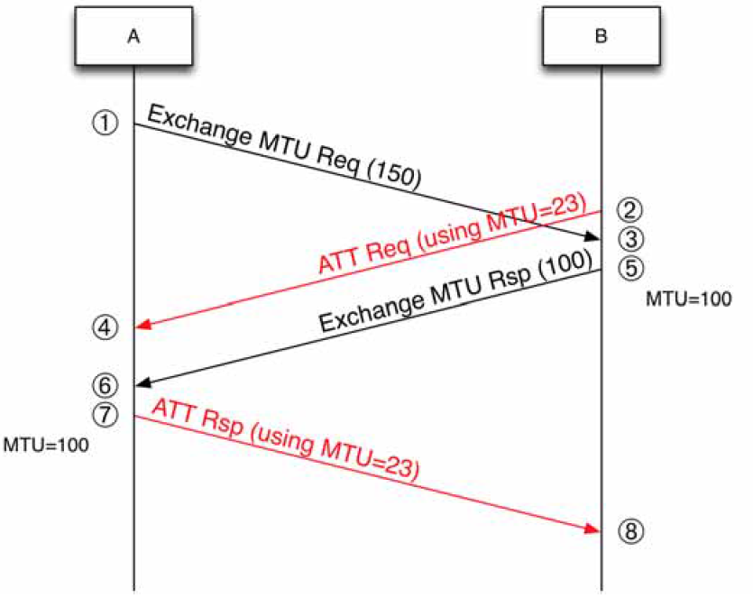
Attribute Protocol PDUs
Error Response: State that a given request cannot be performed, and to provide the reason.
Exchange MTU Request: client informs server of client’s maximum receive MTU size.
Exchange MTU Response: In reply to a received Exchange MTU Request.

Slide 12
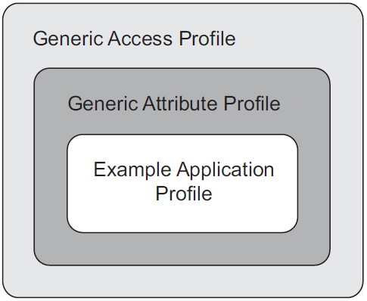
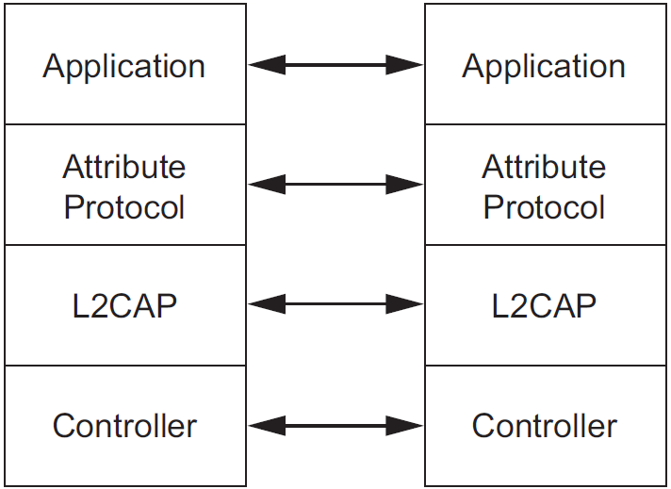
Generic Attribute Profile (GATT)
Define a service framework using Attribute Protocol.
Define procedures and formats of services and their characteristics.
Be used by an application or another profile.
Profile dependencies
Protocol model
Discover
Read
Write
Notify
Indicate characteristics
Broadcast of characteristics
Procedure

Slide 13
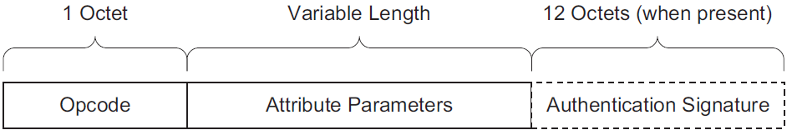
Generic Attribute Profile (GATT)
GATT can be used over any physical link, using Attribute Protocol L2CAP channel.
Attribute Protocol PDU
Opcode: Specific command, request, response, indication, notification or confirmation opcode and a flag for authentication.
Attribute Parameters: Data for specific command or request or the data returned in a response, indication or notification.
Authentication Signature: Optional.

Slide 14
Generic Attribute Profile (GATT)
Service: Collection of data and associated behaviors to accomplish a particular function or feature.
Service is defined by its Service Definition.
Primary Service
Secondary Service
Service Type
Primary Service: Exposes the primary usable functionality of this device.
Secondary Service: Only intended to be referenced from a primary service or another secondary service.

Slide 15
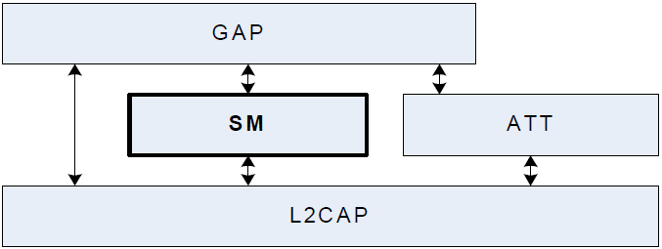
Security Manager (SM)
Security Manager defines:
Methods of pairing and key distribution.
Protocol for those methods.
Security toolbox to be used by those methods.
Security Manager in LE Bluetooth architecture

Slide 16
Security Manager (SM)
Use key distribution to perform identity and encryption functionalities in radio communication.
Each device generates and controls the keys it distributes.
No other device affects the generation of these keys.
The process of pairing:
Phase 1: Pairing Feature Exchange.
Phase 2 (LE legacy pairing): Short Term Key Generation.
Phase 2 (LE Secure Connections): Long Term Key Generation.
Phase 3: Transport Specific Key Distribution.

Slide 17
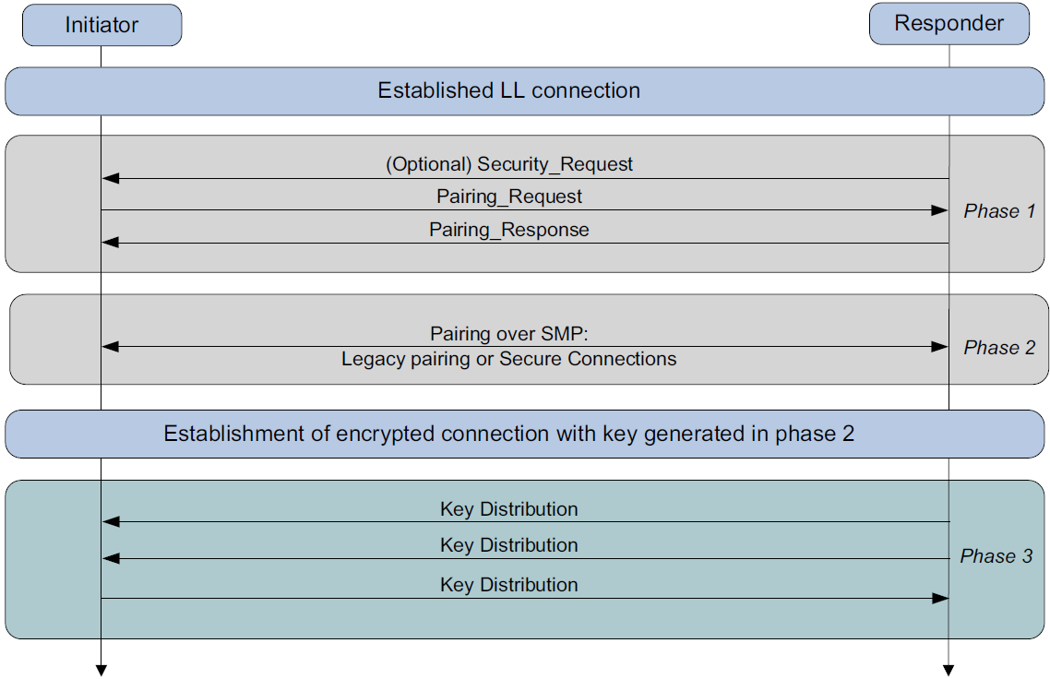
LE Pairing Phases

Slide 18
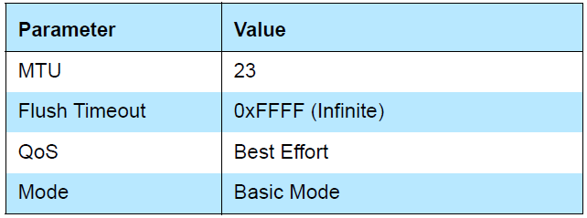
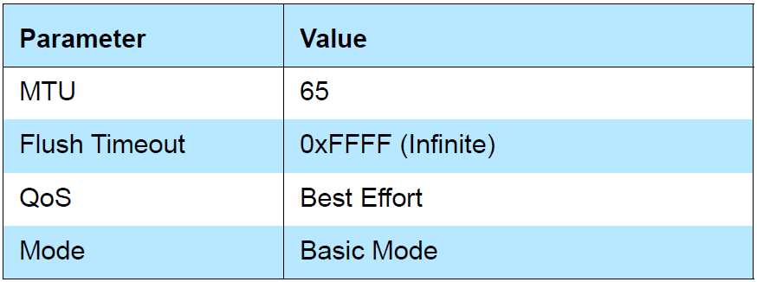
Security Manager Protocol (SMP)
Pair and Transport specific key distribution.
All SMP commands are sent over the Security Manager Channel.
Security Manager Channel is an L2CAP fixed channel.
Security Manager Channel Configuration Parameters
Without LE Secure Connections
With LE Secure Connections

Slide 19
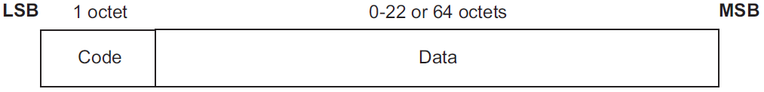
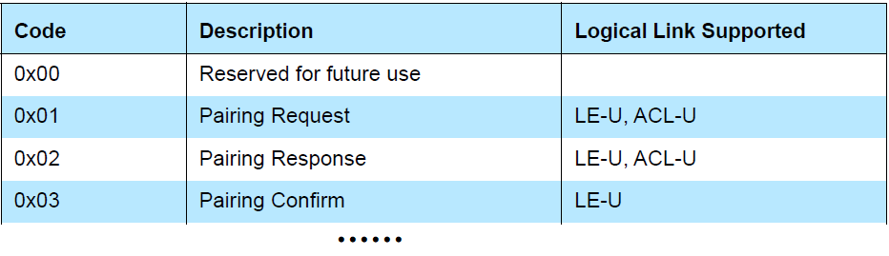
SMP Command Format
Code: Identify the type of command.
Data:
1) Variable in length.
2) Code determines the format of Data.

Slide 20
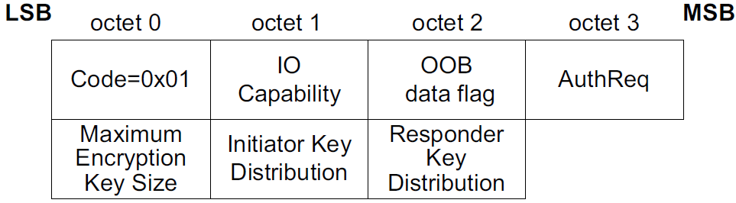
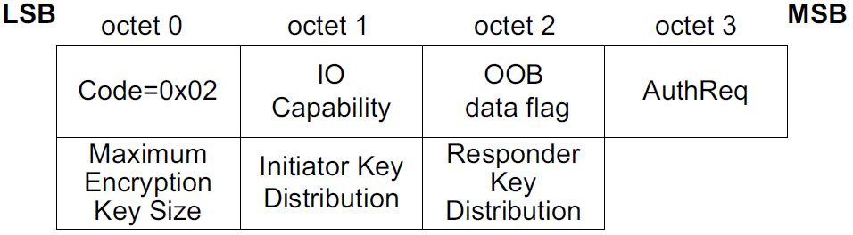
SMP Command
Pairing Request: Initiator starts Pairing Feature Exchange by sending Pairing Request to responding device.
Pairing Response: If responding device allows pairing, it will send Pairing Response.

Slide 21
SMP Command
Pairing Confirm:
Follow a successful Pairing Feature Exchange.
Start STK Generation for LE legacy pairing.
Start LTK Generation for LE Secure Connections pairing.
Initiating device starts key generation by sending Pairing Confirm to responding device.
responding device sends Pairing Confirm after it has received Pairing Confirm from initiating device.

Slide 22
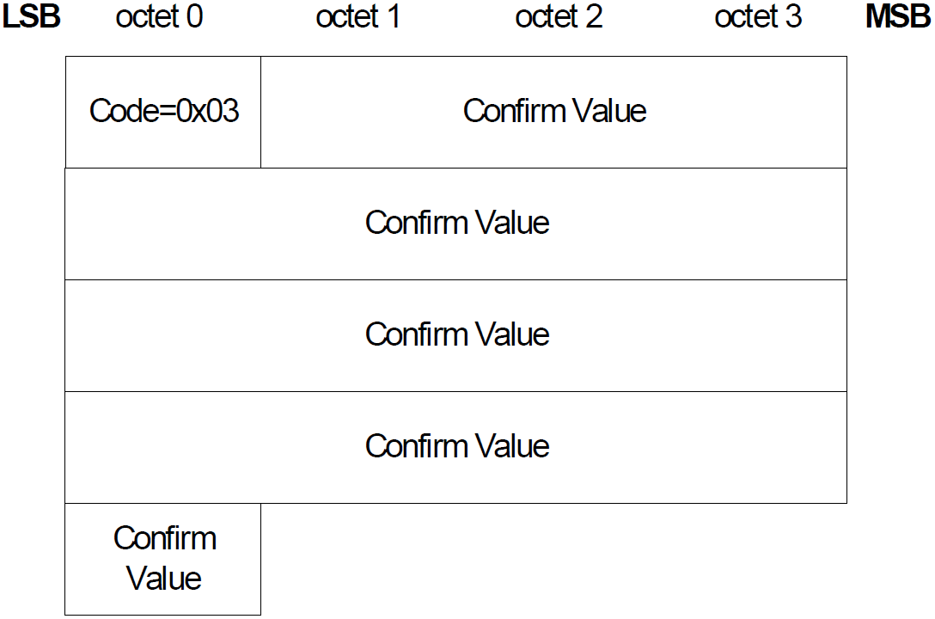
SMP Command
Pairing Confirm Packet

Slide 23
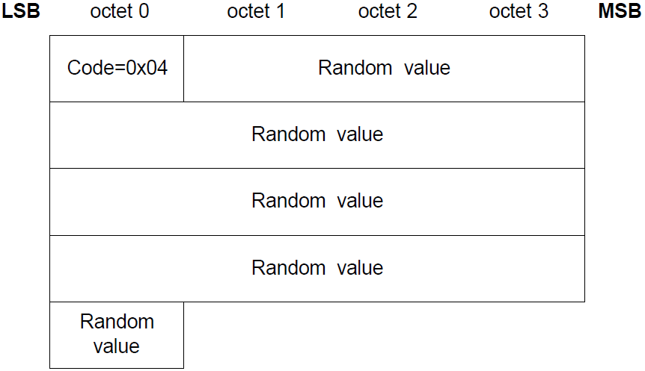
SMP Command
Pairing Random:
Used by initiating and responding device.
Initiating device sends Pairing Random after it has received Pairing Confirm from responding device.
Send random number to calculate Confirm value sent in Pairing Confirm.

Slide 24
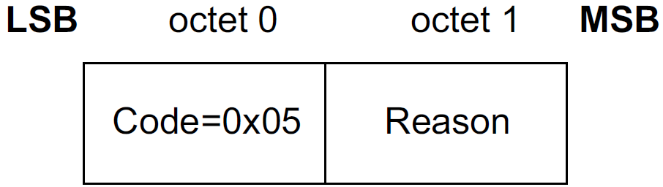
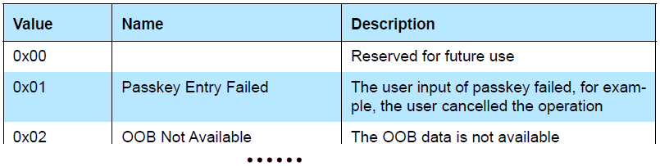
SMP Command
Pairing Failed:
There has been a failure during pairing.
Report that pairing procedure has been stopped.
No further communication for the current pairing procedure is to occur.
Reason

Slide 25

SMP Command
Pairing Public Key:
Transfer the device’s local public key (X and Y coordinates) to the remote device.
Both initiator and responder use this message.
Pairing DHKey Check:
Transmit the 128-bit DHKey Check values (Ea/Eb) generated using f6.
Both initiator and responder use this message.
Keypress Notification:
Inform remote device when keys have been entered or erased.

Slide 26
Host Controller Interface

Slide 27
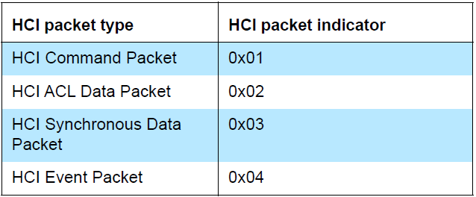
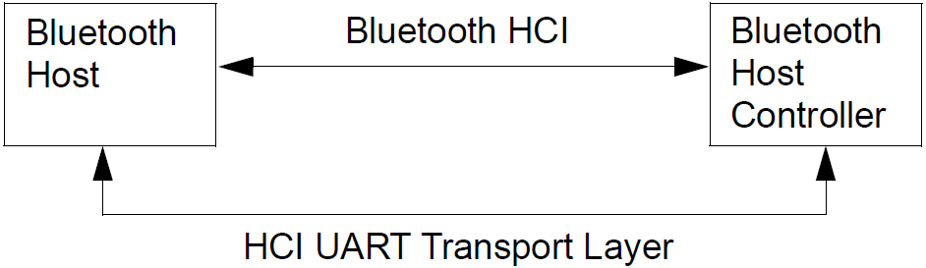
UART Transport Layer
Purpose: Use Bluetooth HCI over a serial interface between two UARTs on the same PCB.
Assume that UART communication is free from line errors.
HCI Command: only be sent to Bluetooth Host Controller.
HCI Event: only be sent from Bluetooth Host Controller.
HCI ACL/Synchronous Data: Sent both to and from Bluetooth Host Controller.

Slide 28
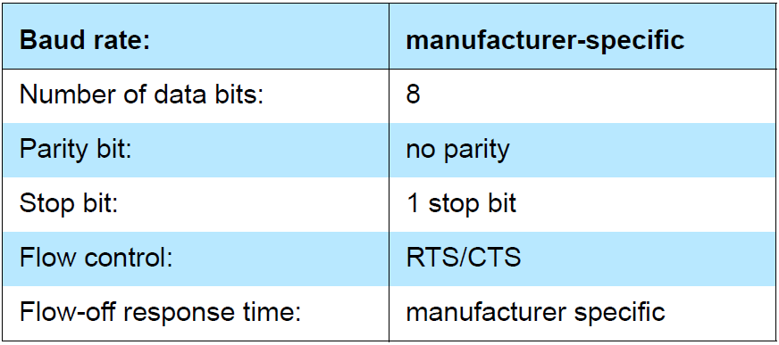
UART Transport Layer
UART Transport Layer uses following settings for RS232:
If UART synchronization is lost from Host to Host Controller, Host Controller shall send Hardware Error Event to Host.
If UART synchronization is lost from Host Controller to Host, then Host shall send HCI_Reset to reset Host Controller.

Slide 29
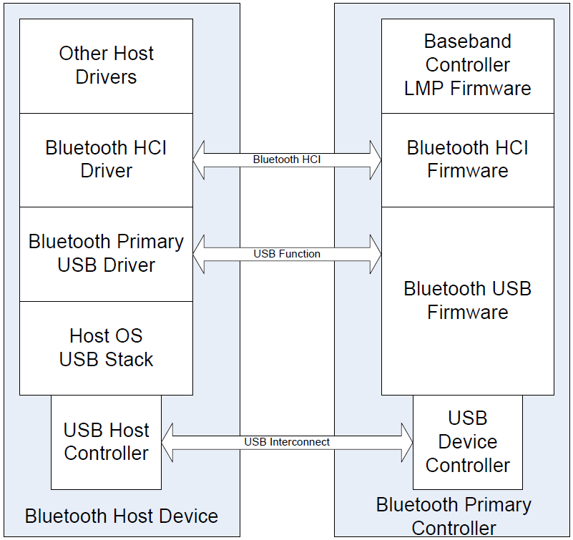
Universal Serial Bus (USB) interface
Relationship between the Host and Bluetooth Primary Controller

Slide 30
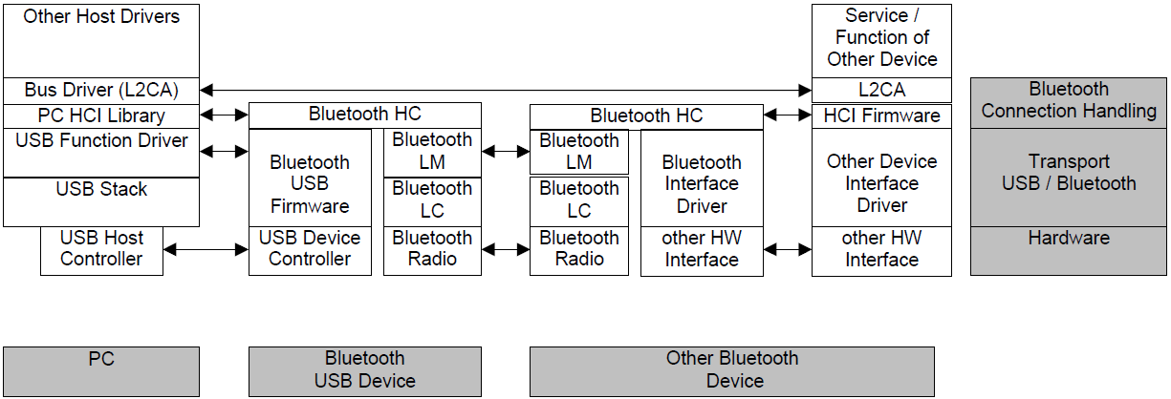
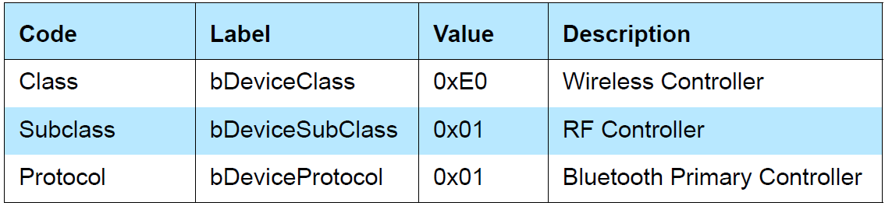
Universal Serial Bus (USB) interface
Flow of data from one Bluetooth device to another
The endpoint numbers may be dynamically recognized upon driver initialization.
A class code will be used that is specific to all USB Bluetooth devices. It allows the proper driver stack to load.

Slide 31
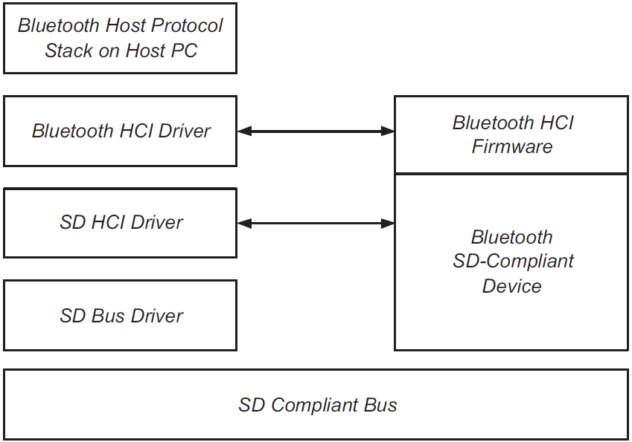
Secure Digital (SD) interface
All data is transferred in blocks as packets.
Define segmentation and recombination protocol.
Provide different data rate options.
SD Communication Diagram

Slide 32
Three-Wire UART Transport Layer
Use Bluetooth HCI over a serial interface between two UARTs.
Connection based protocol.
Transports HCI commands, events, ACL and Synchronous packets between Host and Controller.
Add a packet header onto the front of every HCI Packet.
Frame the packets using a SLIP protocol.
Send this packet over the UART interface.
Packet
Construction

Slide 33
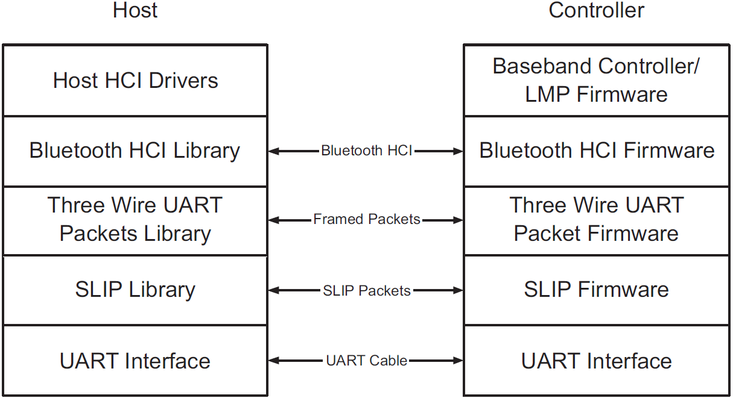
Three-Wire UART Transport Layer

Slide 34

SLIP Layer
Convert an unreliable octet stream into an unreliable packet stream.
Place start and end octets around the packet.
Change all occurrences of the frame start or end octet in the packet to an escaped version.
Place octet 0xC0 at start and end of every packet it transmits.
0xC0 in the packet is changed to 0xDB 0xDC.
0xDB in the packet is changed to 0xDB 0xDD.

Slide 35
SLIP Layer
The device must discard all octets until it finds 0xC0.
If 0xC0 is followed immediately by a second 0xC0, then the device will discard first 0xC0.
It changes SLIP sequences back into unencoded form.
When decoding 0xC0 at the end of the packet, it will calculate the length of SLIP packet.
It will pass the packet data into the packet decoder.
It will seek the next packet.

Slide 36
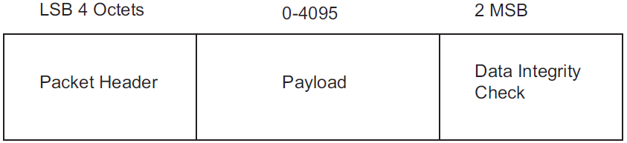
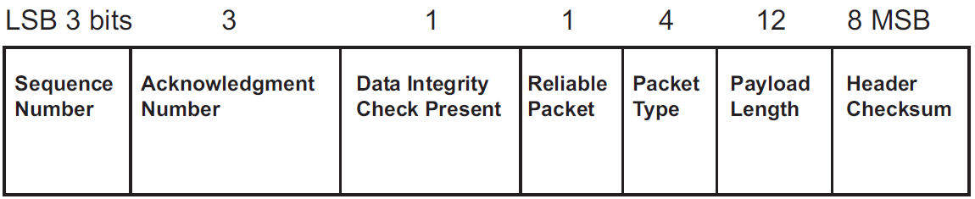
Three-Wire UART Transport Layer
Packet Format
Packet Header Format
For unreliable packets, it will be set to 0 on transmit and ignored on receive.
Each reliable packet will be assigned a sequence number.
sequence number will be equal to sequence number of the previous reliable packet plus one modulo eight.
A packet will use the same sequence number each time it is retransmitted.

Slide 37
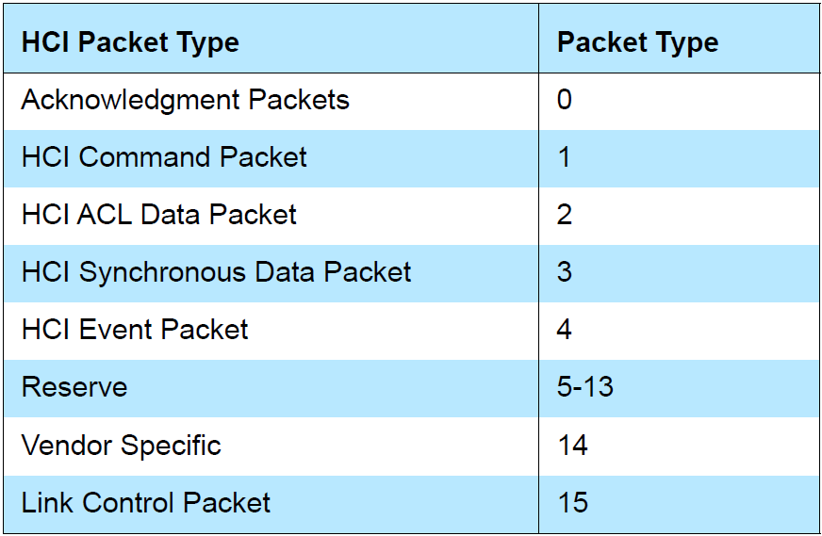
Three-Wire UART Transport Layer
HCI Command
HCI Event
HCI ACL Data
HCI Synchronous Data
HCI packets via Three-Wire
UART Transport Layer
HCI Command
HCI ACL Data
HCI Event
Reliable
Packets

Slide 38
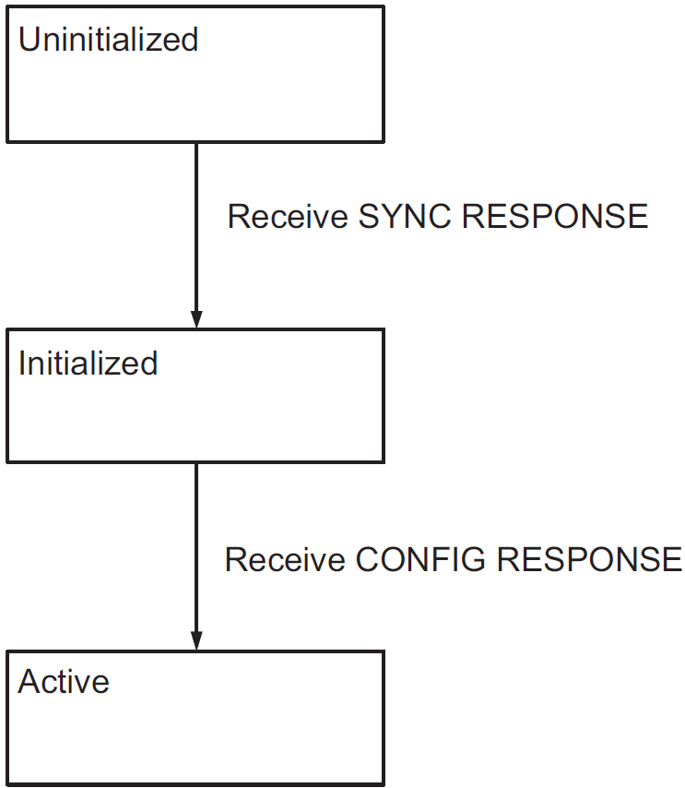
Link Establishment
Before any packets except Link Control Packets can be sent, Link Establishment procedure must be performed.
Uninitialized
Initialized
Active
Link Establishment State
SYNC
SYNC RESPONSE
CONFIG
CONFIG RESPONSE
Message

Slide 39
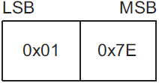
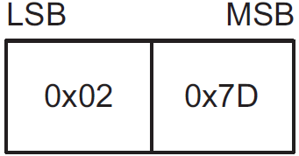
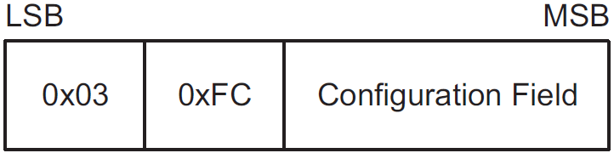
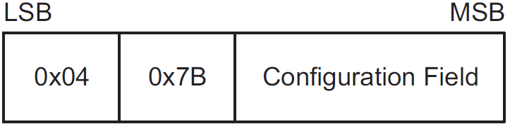
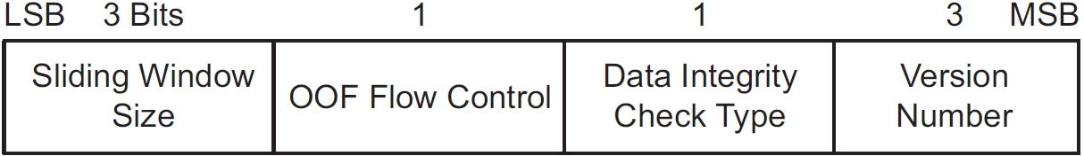
Link Establishment
SYNC:
SYNC RESPONSE:
CONFIG:
CONFIG RESPONSE:
Configuration Field

